Slide 1


Image retrieval using cifar-10 dataset
PRESENTED BY:
Nikhil Duggireddy – 1001968033 Laya Kalali – 1002128876 Sasikala Paturu – 1002083123 Lokeshwar Kodipunjula - 1002175121

Slide 2

INTRODUCTION
Image retrieval refers to the process of searching for and retrieving images from extensive datasets based on their visual content. This technique is widely used across domains such as e-commerce, social media, and digital archives, where users seek to locate images similar to a specified query image. This project presents an image retrieval system utilizing the CIFAR-10 dataset, a popular dataset employed in tasks like image classification and retrieval. By using deep learning and extracting features with a pre-trained convolutional neural network (CNN), the goal is to identify and retrieve images that closely resemble a given query image.

Slide 3
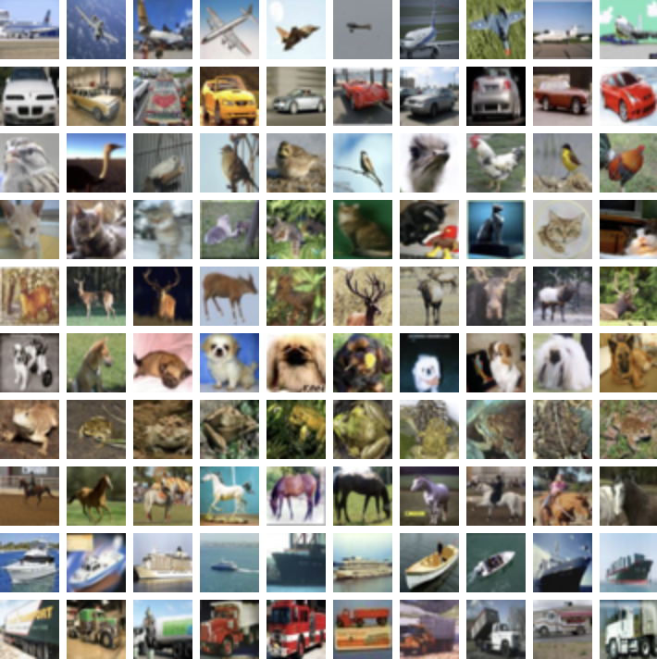
Dataset overview
The CIFAR-10 dataset is a labeled dataset containing 60,000 images categorized into 10 classes. Each image is of size 32x32 pixels, representing objects like airplanes, automobiles, birds, cats, and more. The dataset is divided into 50,000 training images and 10,000 testing images. For this project, we resize the images to fit the input requirements of a pre-trained ResNet50 model, which requires a minimum resolution of 32x32

Slide 4
METHODOLOGIES
Preprocessing: We resize and preprocess the images to prepare them for input to the ResNet50 model.
Feature Extraction: Using a pre-trained ResNet50 model, we extract high-dimensional feature vectors from the images, representing each image's unique characteristics.
Nearest Neighbors Search: Find images with similar features.
Display Results: Display the query image alongside similar retrieved images

Slide 5
PREPROCESSING AND FEATURE EXTRACTION
.
Preprocessing:
Resize CIFAR-10 images to 32x32 pixels to fit ResNet50 input
requirements.
Apply pre-processing suited for the ResNet50 model.
Feature Extraction:
Use a pre-trained ResNet50 model without the final
classification layer.
Extract feature vectors that capture visual content of images.
These vectors represent unique visual characteristics of each
image.

Slide 6
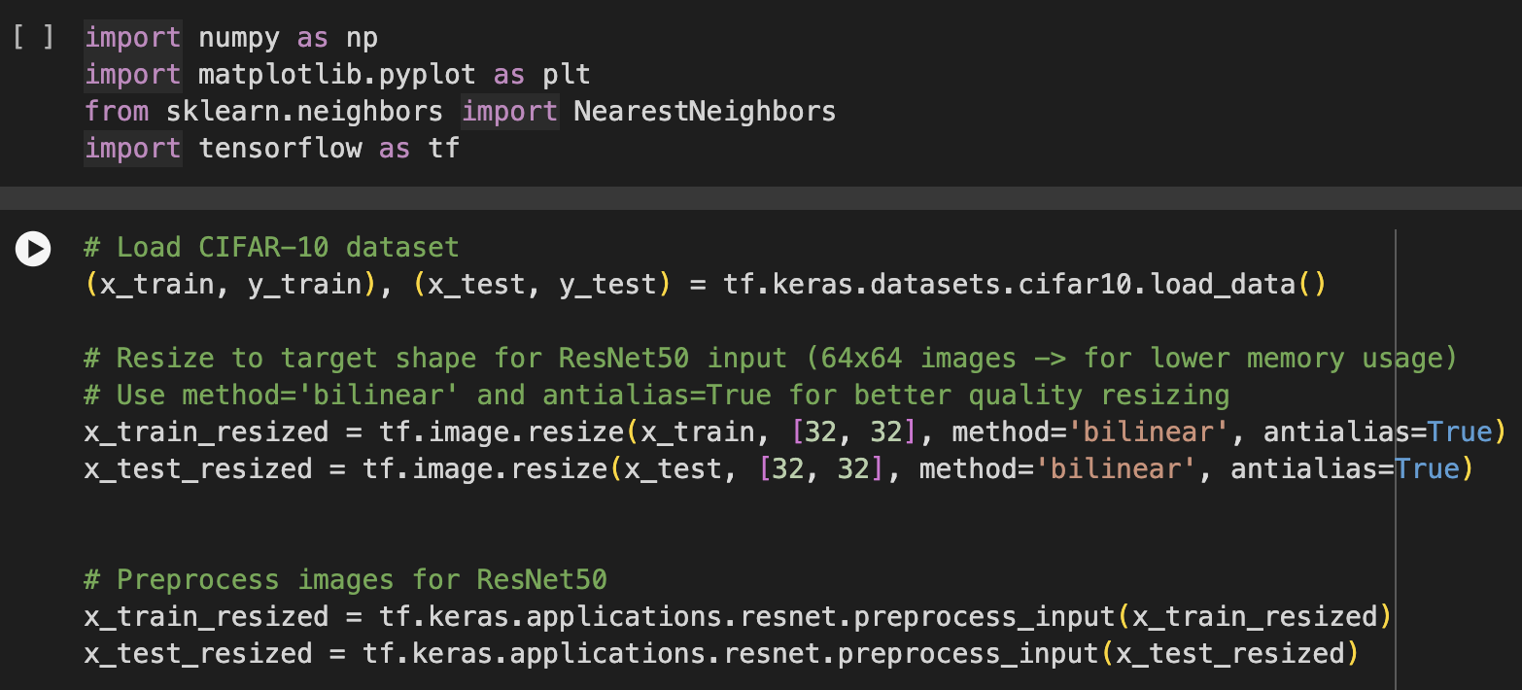
CODE SNIPPETS
:
Data Loading & Preprocessing:
CIFAR-10 images are resized to 32x32 to match ResNet50’s input size.

Slide 7
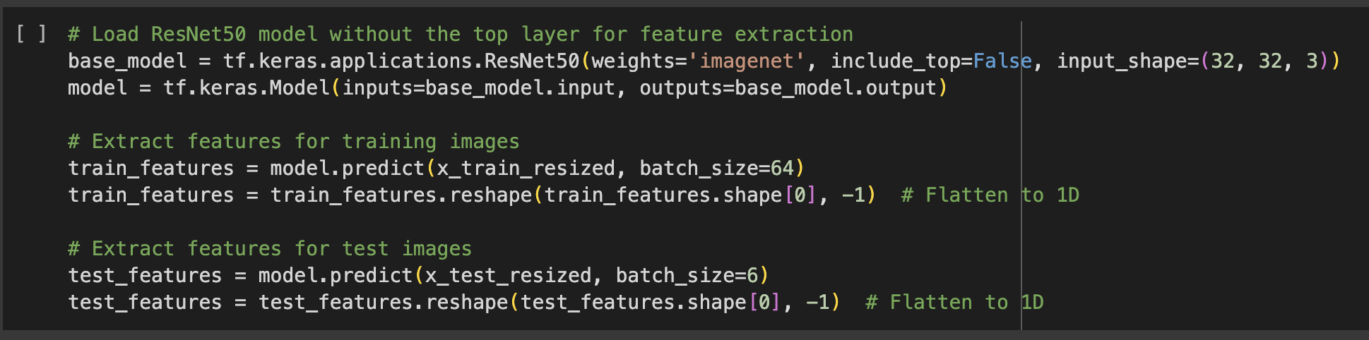
Feature Extraction:
Using ResNet50 without the top layer to extract meaningful features.

Slide 8
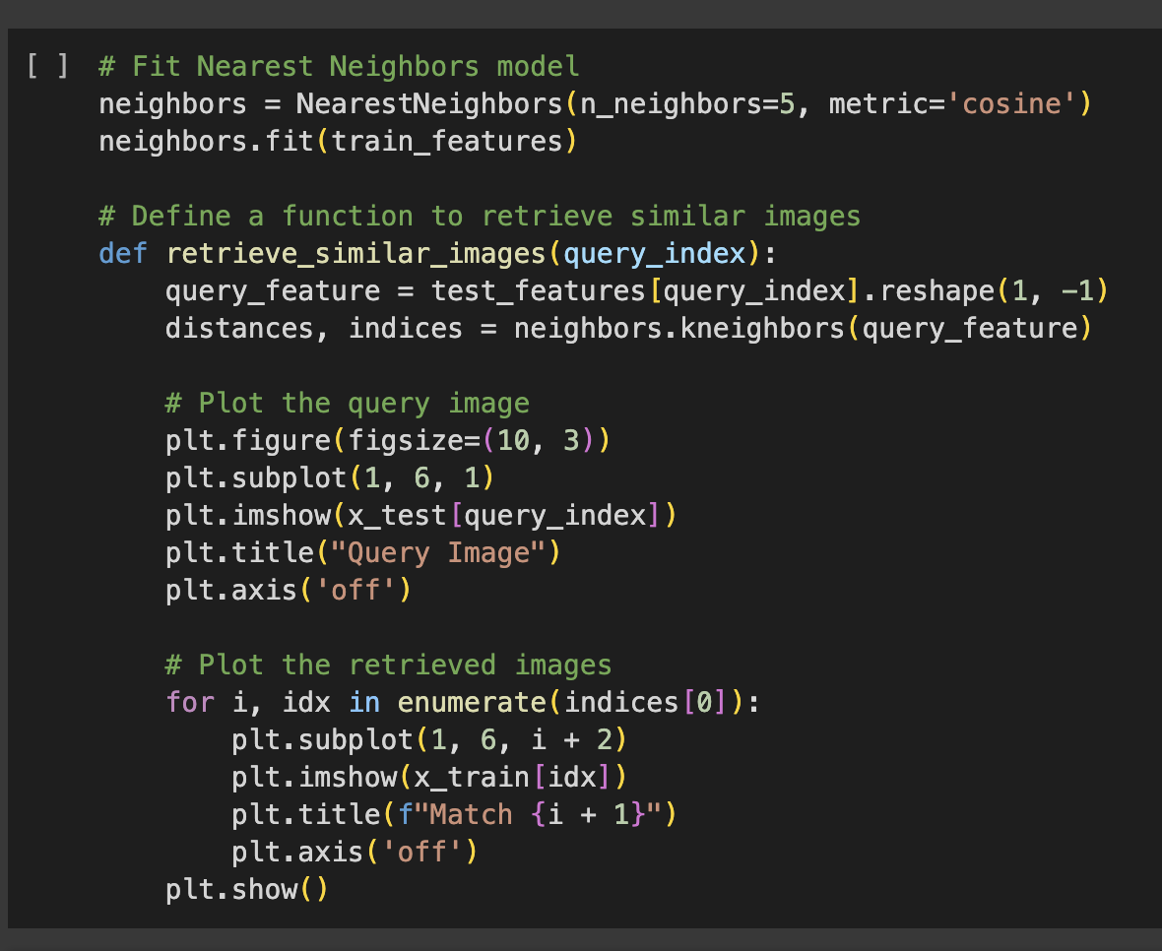
Image Retrieval with Nearest Neighbors:
Fit a Nearest Neighbors model using cosine similarity on feature vectors for efficient similarity search.

Slide 9
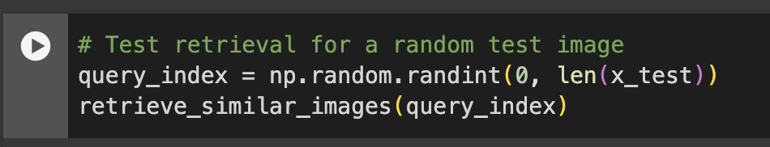
Image retrieval for a random test image:

Slide 10
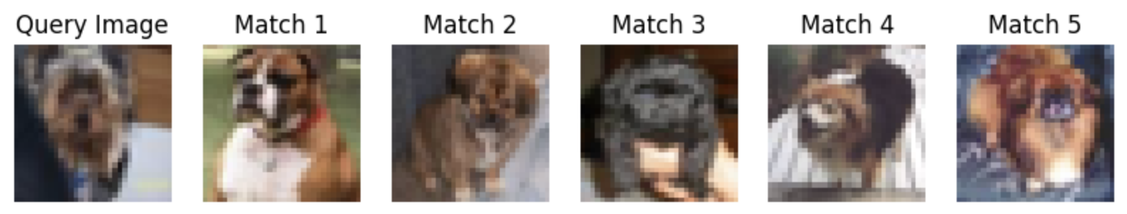
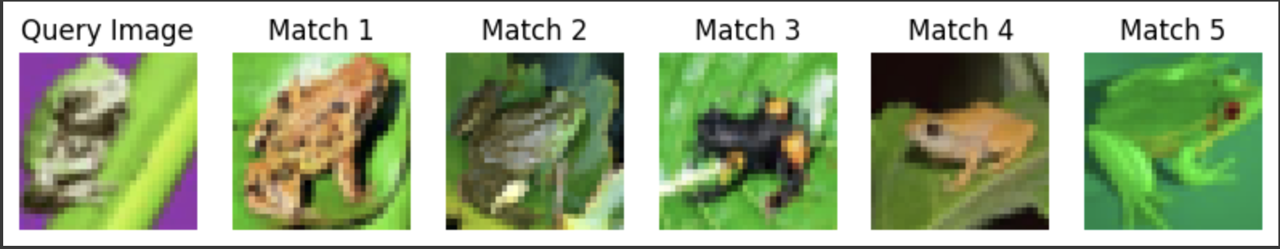
Experiments and Results:
Example Results
Query Image: An image from the test set.
Retrieved Images: Top 5 visually similar images
from the training set.
Observations:
Retrieved images show similar visual traits (color,
shape, object type).

Slide 11
DISCUSSION:
Advantages:
ResNet50 captures useful visual features for similarity retrieval.
Nearest neighbors with cosine similarity yields reasonable results.
Limitations:
Low-resolution images may limit fine-grained similarity.
High computational cost due to large feature vectors.
Future Improvements:
Experiment with different pre-trained models or fine-tune on CIFAR-10.
Use approximate nearest neighbors for faster retrieval and better image resolution of
224x224 pixels.
Incorporate text metadata along with images to facilitate multimodal search
capabilities, enhancing retrieval precision by utilizing additional context.

Slide 12
COnCLUSION:
Summary:
We built an image retrieval system with CIFAR-10, using deep learning to extract feature embeddings and retrieve similar images efficiently.
While CIFAR-10 allowed us to explore the basics, future improvements in scalability, embedding quality, and multimodal capabilities will enhance real-world applications.
Key Takeaways:
Image retrieval benefits from powerful feature representations.
Potential applications span various domains requiring similar image search.

Slide 13
THANK YOU

